Slide 1
STOCK MANAGEMENT SYSTEM

Slide 2

INTRODUCTION
Basically we have created an app named "Stock management system" on the basis of java and database system.
The aim behind the app is to make shopkeepers work easier and smoother. This app helps shopkeepers to keep the note of their stocks and manage them. Almost null requirements makes it easier for user to use. The back end of this app is based on java and database is also used in there.
On the point of security, the process of login credentials is also kept in the app. The further details are shown in the next slides.

Slide 3

PROBLEM STATEMENT
Is that Common problem for any small shop to big company owner to manage their stock ?
Also some time it is hard to remember price of particular product.
It make loss in business or destroy relation with customer.
Is it right that if you not manage your stock in right way then it become a cause of lose in business ?

Slide 4
PROPOSED SYSTEM
We proposes a digital system for Stock management.
The system have a verification process for security (user-id and password system).
It has following functions –
1. Users- to manage users of this application
2. Category- to manage category of products in the shop
3. Stock- to manage price, available pieces of product of different category
4. Order- to manage orders
5. Customer-to store details of customer
6. Billing system

Slide 5
CURRENT SYSTEM & IT’S LIMITATION
In today scenario, Most shopkeepers or owner of company manage their stock by writing it down in a book or by memorizing it.
But what about in case of lose of that book or forgot that thing??
In this case there is a chance to Loss in business.

Slide 6
Continue….
Owner
User
verification
Users
Category
management
Product
management
Customer management
Order management
Password
Add new user
Delete user
Edit user details
Add new category
Check/manage available product of category
Add new product
Check/manage available Product.
Set price of a product
Edit a order
Check order details
Differentiate
best orders
Add new customer
Check customer details
Differentiate
old customer with new customer

Slide 7
SHOPS
SCOPE
FACTORY
HOTELS

Slide 8

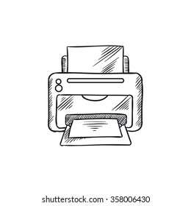

REQUIREMENTS
Computer
Printer
Java and its Libraries

Slide 9
Flow chart

Slide 10
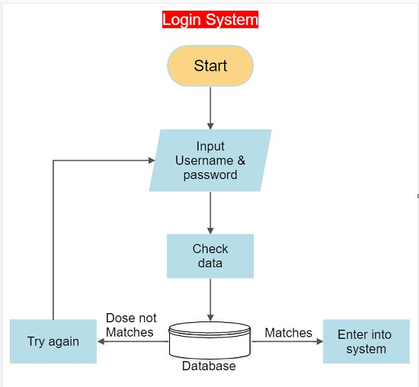
Continue…

Slide 11
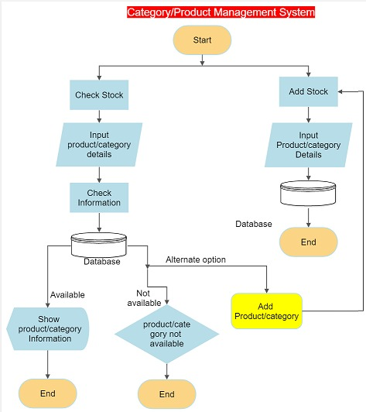
Continue….

Slide 12
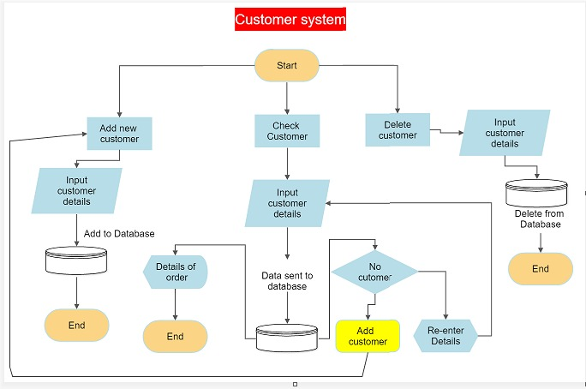
Continue…

Slide 13
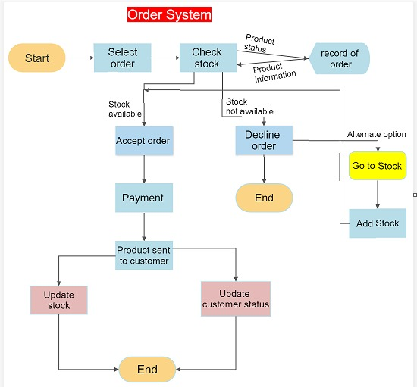
Continue…..

Slide 14

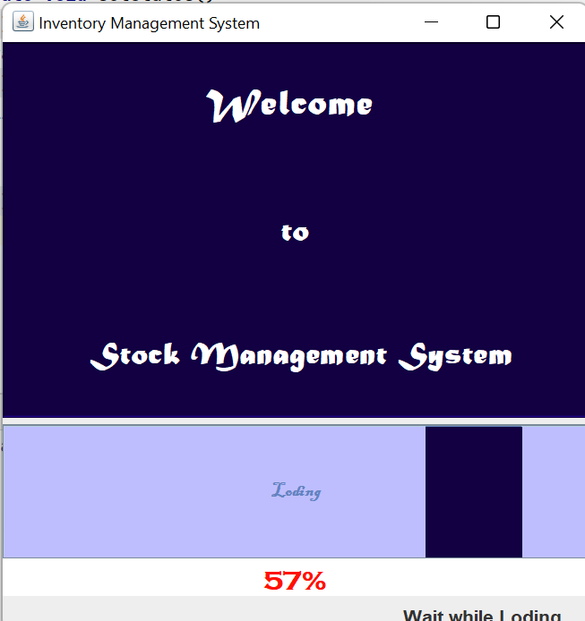
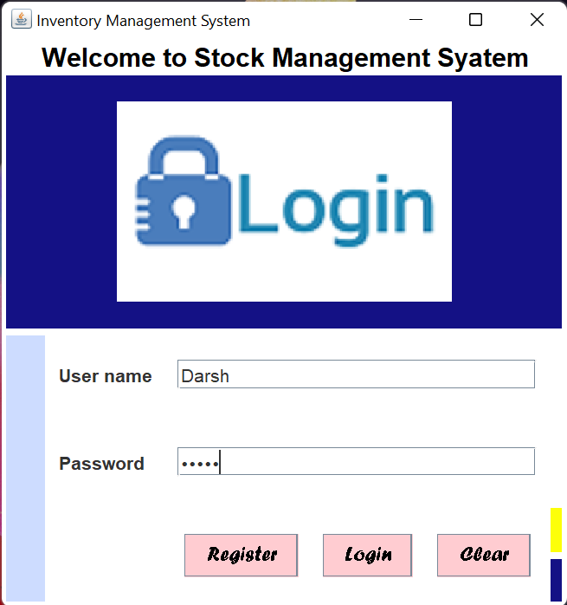
Screenshot Of Output:

Slide 15
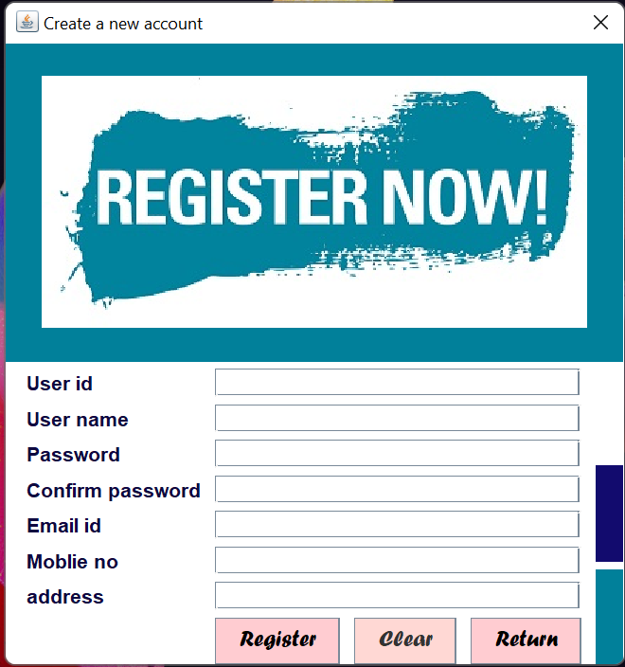
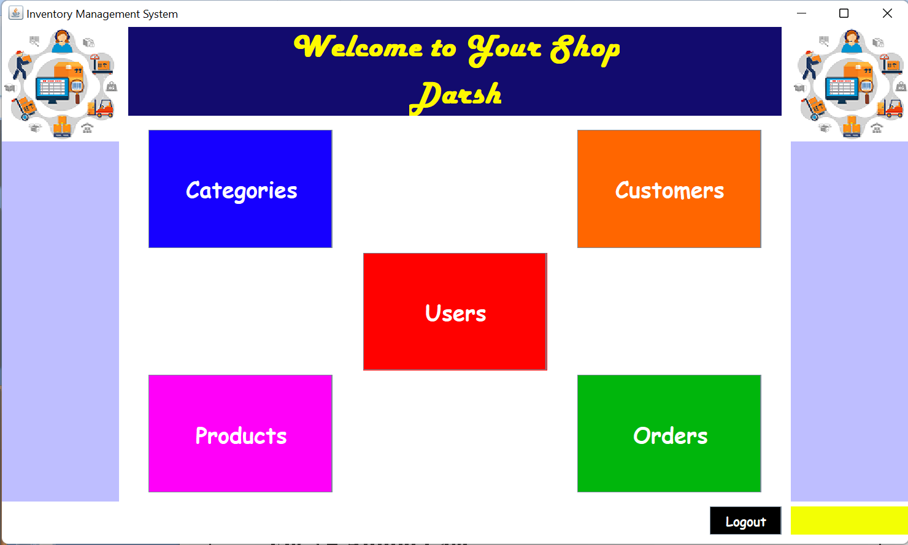

Slide 16
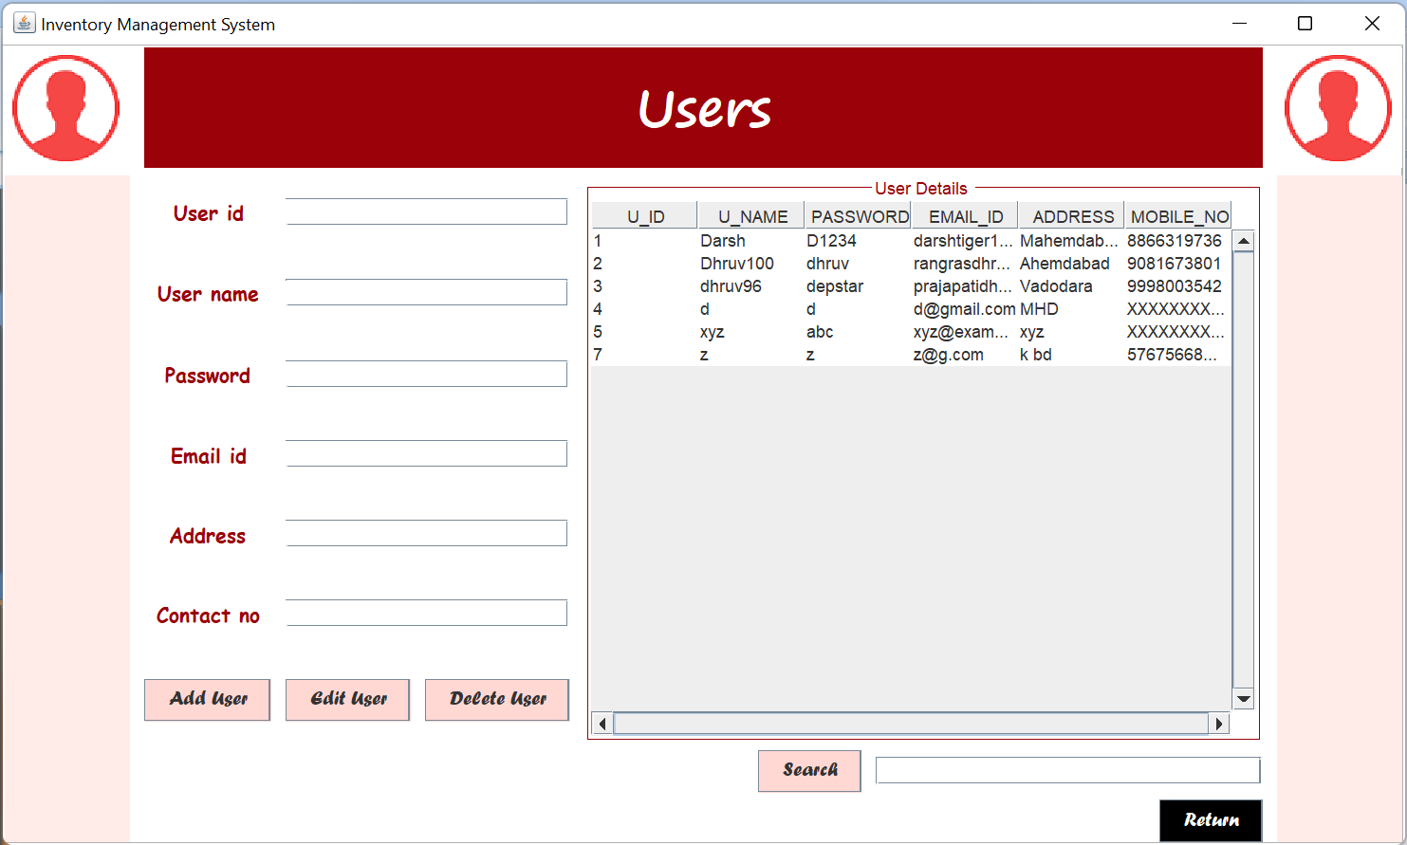
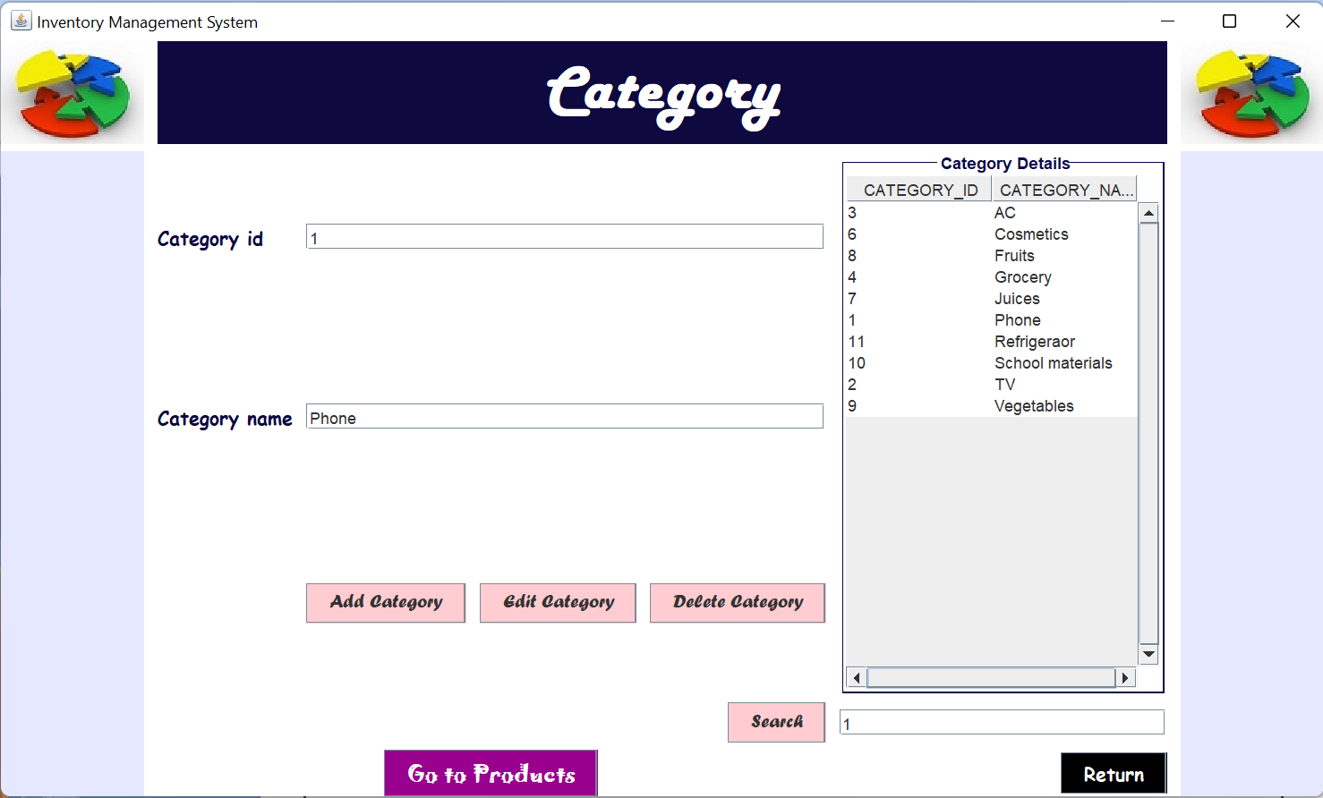

Slide 17
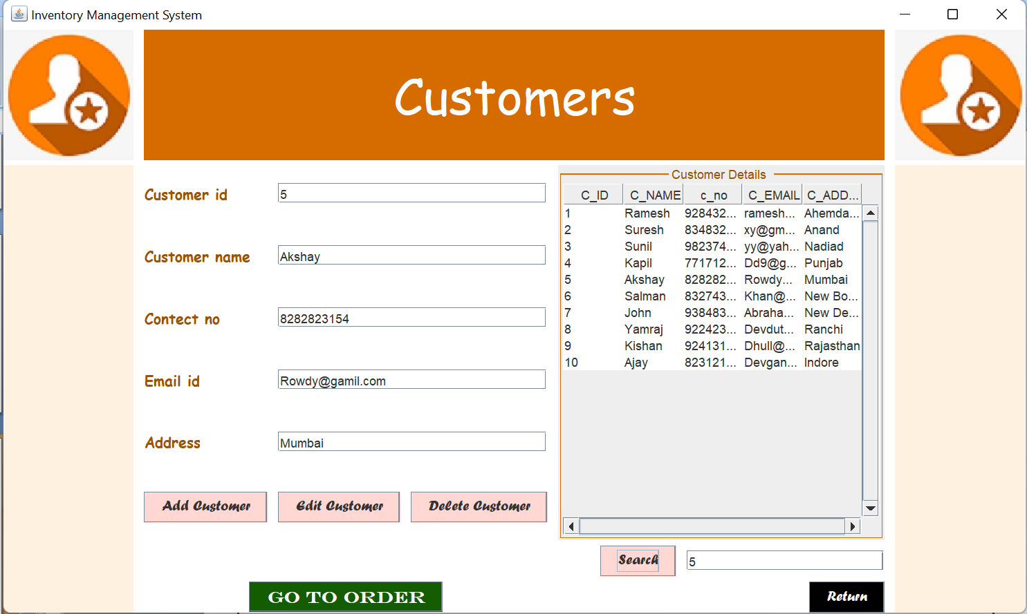
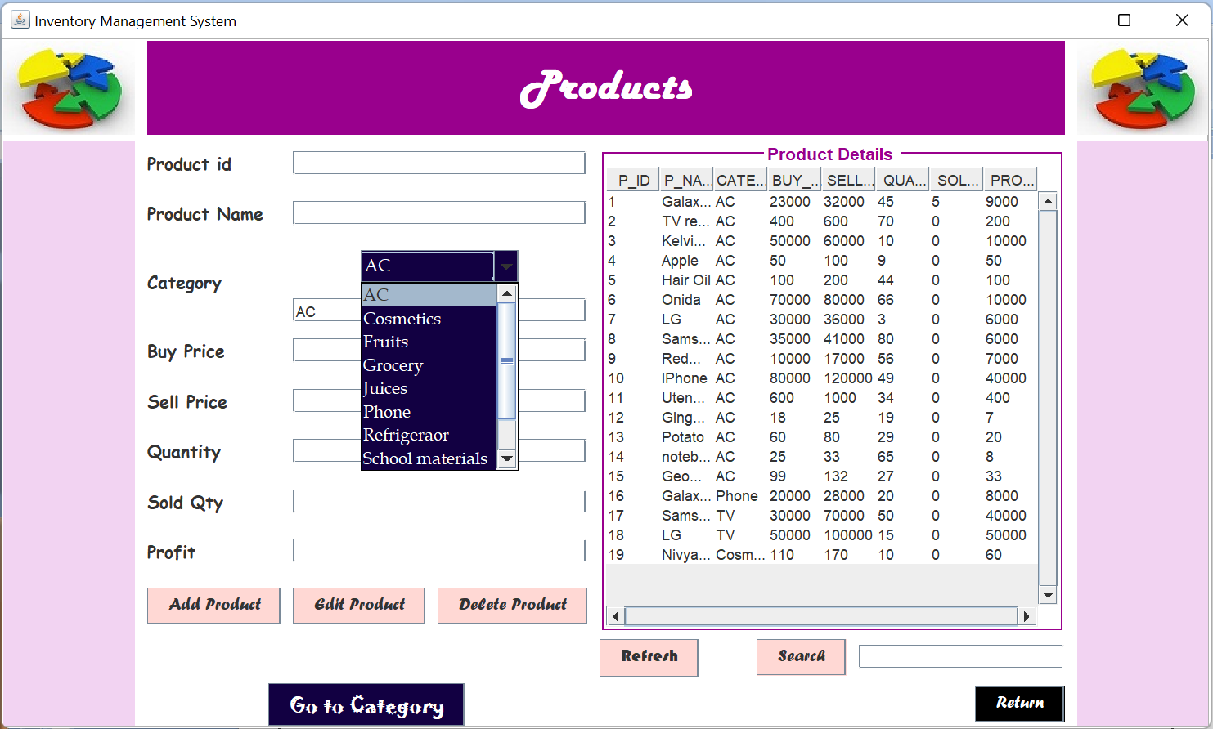

Slide 18
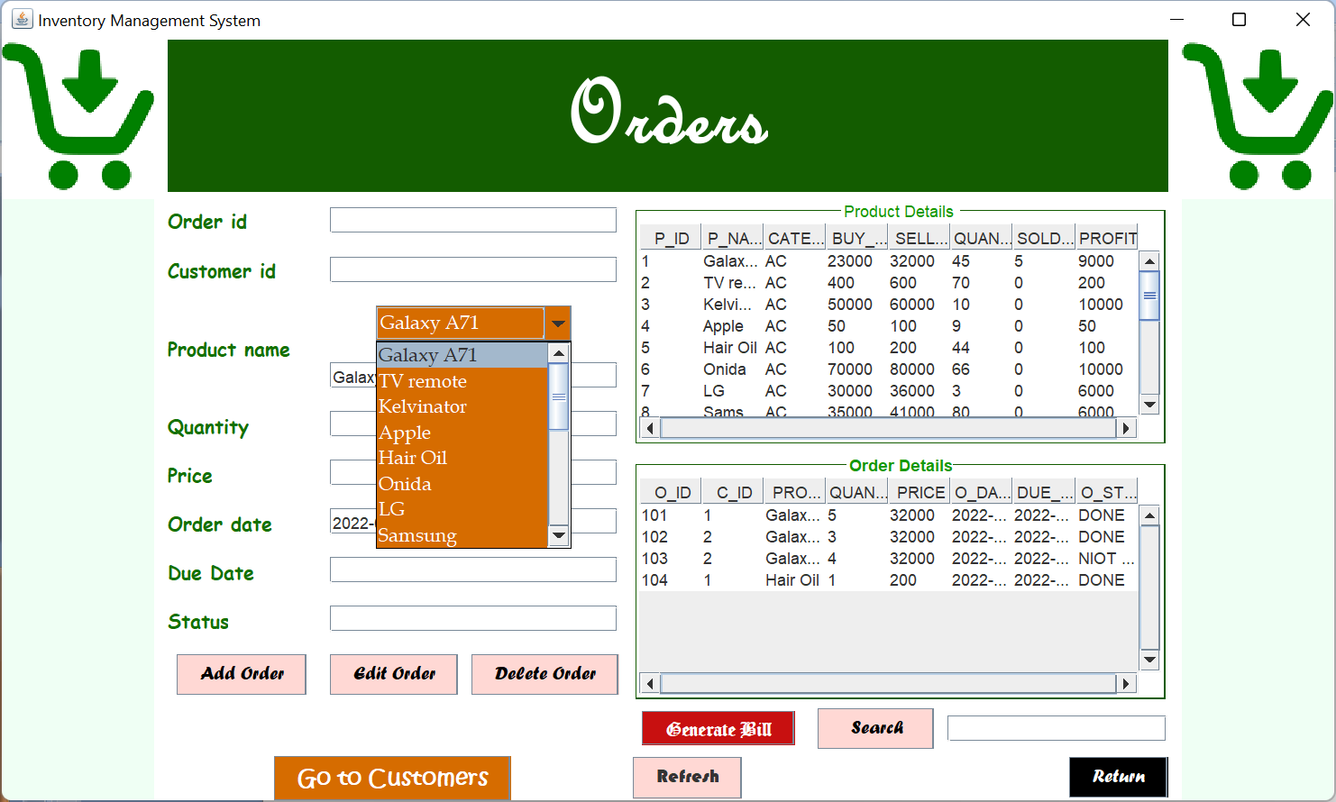

Slide 19
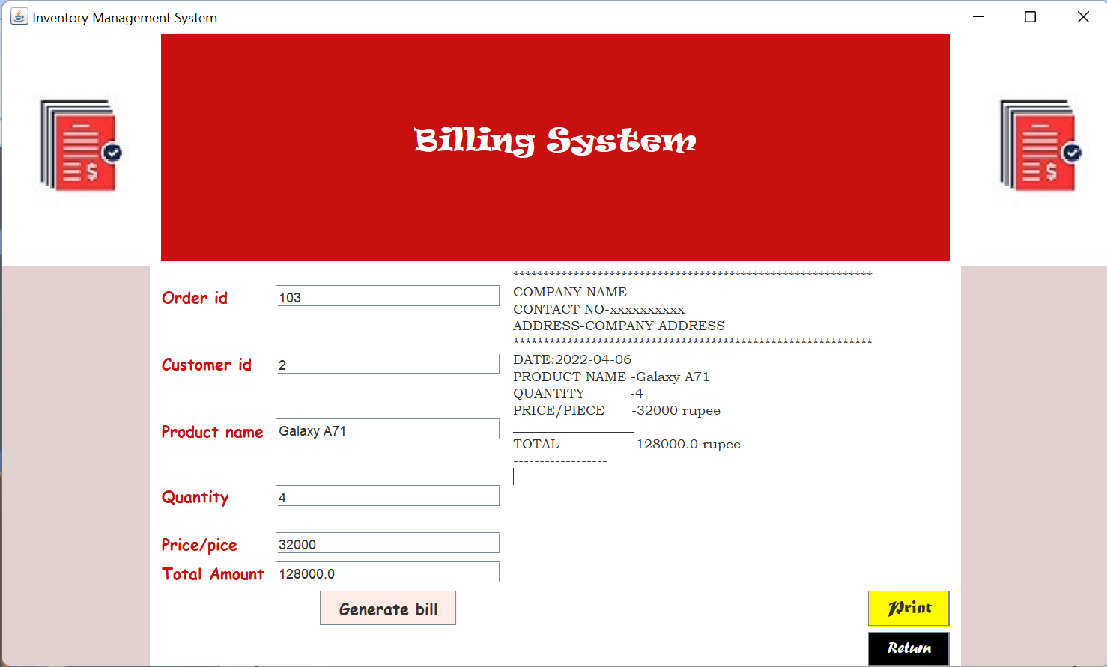
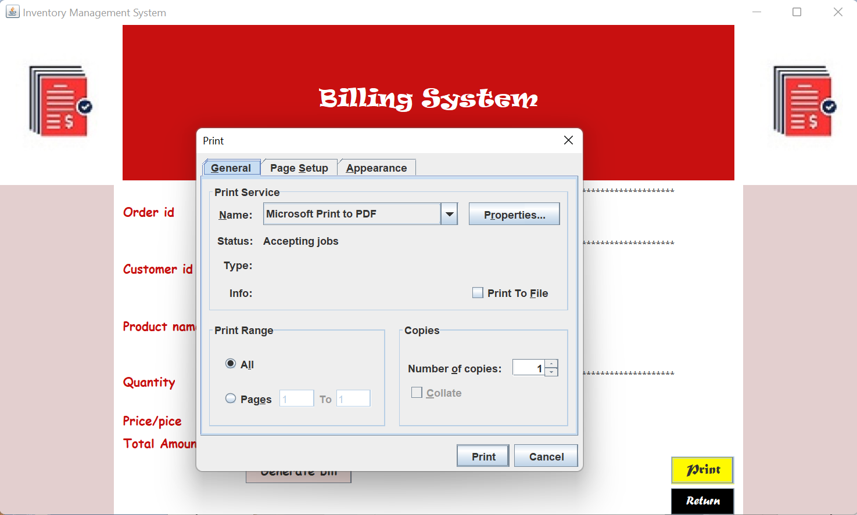

Slide 20
ADVANTAGES
It is more efficient then writing it down in a book or by memorizing it.
Easy to analyze demand & trend of different products.
There is no any fear of losing data.
It is a way to get more profit.
Easy to manage stock and orders .

Slide 21

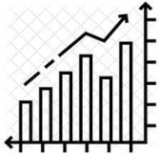

Limitations
Here is no any facility for Graphical representation of available stock & the trend of particular product in market.
This application can't manage order delivery.
This limitations will get covered in future

Slide 22
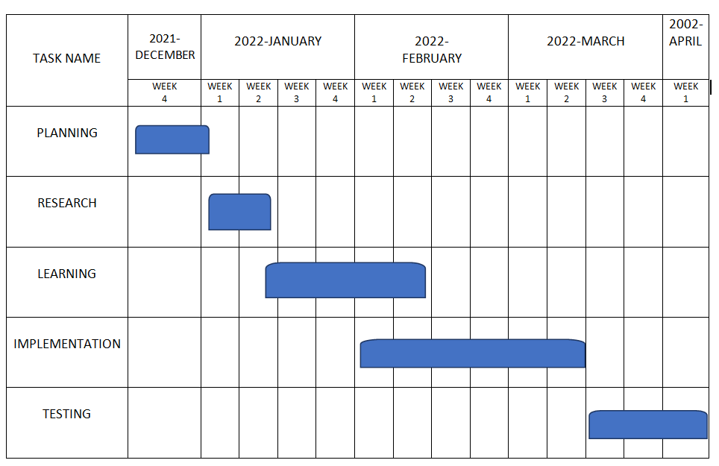
Gantt chart

Slide 23
REFRENCES
https://www.youtube.com/watch?v=HfSQL2H7_mE
https://procoders.tech/blog/how-to-make-inventory-management-software/
https://www.youtube.com/watch?v=VpwLw42vrwU
https://www.javatpoint.com/java-swing
https://www.javatpoint.com/java-jdbc
https://www.youtube.com/watch?v=3xAM-Bmr4yw
https://www.w3schools.com/mySQl/default.asp
https://www.javatpoint.com/mysql-tutorial
https://www.youtube.com/watch?v=wifRYaPiiM0&list=PLUDwpEzHYYLvWEwDxZViN1shP-pGyZdtT
https://www.youtube.com/watch?v=5vSyylPPEko

Slide 24
THANK YOU

